Slide 1

Coupon Problem
https://github.com/prapons01/UCB_AIML/blob/main/prompt.ipynb
Raju Ponniah
prapons@hotmail.com

Slide 2
Overview of the data
Total 2.5+ MB dataset, with 12,684 rows
26 columns in total
8 numeric columns and 18 categorical columns
74 duplicate rows based upon all columns (since the data set does not have a primary no further actions needed)
Missing data:
Except Car all other missing data are <1%
Car | 12,576
Bar | 107
CoffeeHouse | 217
CarryAway | 151
RestaurantsLessThan20 | 130
Restaurants20to50 | 189

Slide 3
Decision on Missing Data
Coupon Accepted
Dropped the CAR column, since most of the values are null
Filled in the missing data for “Bar”, and “RestaurantLessThan20” based upon values in the other columns of similar rows.
57% of time the coupons are accepted. The coupon campaign has the potential to bring more revenue for the organization.
Note 1: We have not analysed the utilization of the coupons
Note 2: The cost associated with the campaigns are also unknown. Which will impact the overall profitability of the organization

Slide 4
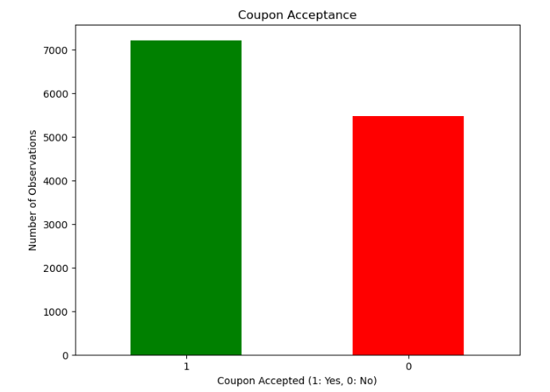
Coupon Accepted Histogram

Slide 5
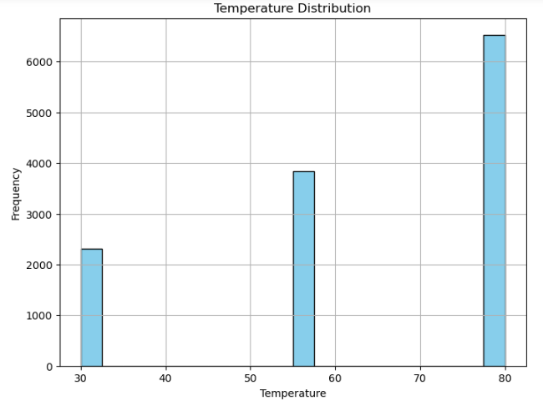
Temperature Distribution Histogram
More coupons are sent during high temperature, probably more tagteted to Bar goers

Slide 6
Coupon acceptance
What proportion of bar coupons were accepted?
Bar Coupon acceptance = 41%
Overall looks like it is good strategy to grow revenue by sending coupons
Compare the acceptance rate between those who went to a bar 3 or fewer times a month to those who went more.
The acceptance rate between those who went to a bar 3 or fewer times a month to those who went more is 4.40 times
Those who went to bar the least amount of time, accepted the coupons to go bar. It is a good group to target the coupons.

Slide 7
Coupon acceptance
Compare the acceptance rate between drivers who go to a bar more than once a month and are over the age of 25 to the all others. Is there a difference?
The ratio between the groups is 14.00% only. There is an incremental acceptance in this specific group.
Use the same process to compare the acceptance rate between drivers who go to bars more than once a month and had passengers that were not a kid and had occupations other than farming, fishing, or forestry.
The acceptance rate is 35% higher than normal acceptance. It is a very good group to focus on sending coupons.
Compare the acceptance rates between those drivers who:
go to bars more than once a month, had passengers that were not a kid, and were not widowed OR
go to bars more than once a month and are under the age of 30 OR
go to cheap restaurants more than 4 times a month and income is less than 50K.
The ratio is ~ 50%. So this group is more likely to accept the coupons within the people who accepted the bar coupons
Note: Further analysis is needed on the influence of No Kid

Slide 8
Overall Hypothesis on further analysis
temperature 0.050984
has_children -0.196812
toCoupon_GEQ5min NaN
toCoupon_GEQ15min -0.043942
toCoupon_GEQ25min -0.028080
direction_same 0.049500
direction_opp -0.049500
There is a positive correlation between the temperature and direction of the destination and strong negative correlation if the children are present on acceptance of coupons

Slide 9
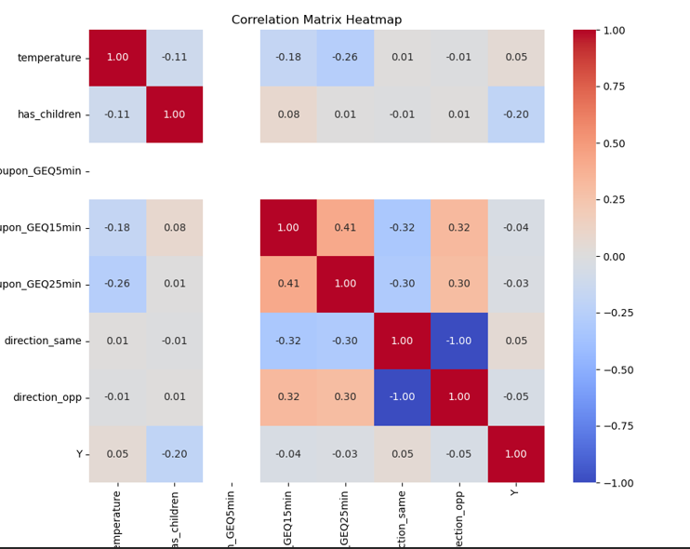
Correlation analysis in a heatmap format

Slide 10
Independent Analysis on “ Restaurant <20”
Income is a one of the driver in some of the decisions we make…so converted the ranges into value of higher value as int column
temperature 0.181211
has_children -0.019501
income -0.031402
toCoupon_GEQ5min NaN
toCoupon_GEQ15min -0.112715
toCoupon_GEQ25min -0.296467
direction_same -0.075862
direction_opp 0.075862
There is a positive correlation between the temperature and direction of the destination on acceptance of coupons

Slide 11
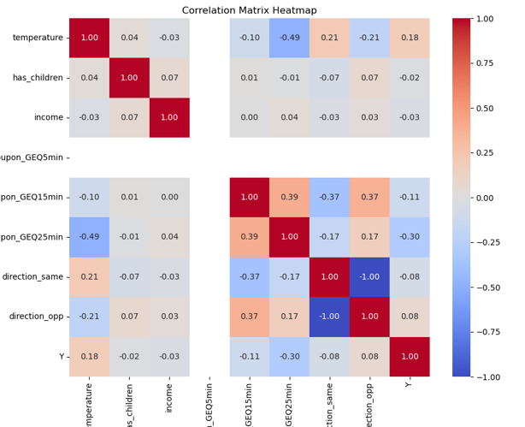
Independent Analysis on “ Restaurant <20”
Note: the surprising thing is income has no-correlation to the acceptance of “restaurant <20” coupons.

